Slide 1
MediaServer C Series
Multi-channel SD/HD/4K Video Server
Notes:
Rev002
Date: 2016/01/15
Add 2In2Out in the table in Page5.
Add description “Support for graphic like logo, image” in Page6.
Rev 001
Date: 2015/01/26
Update storage drives and features

Slide 2
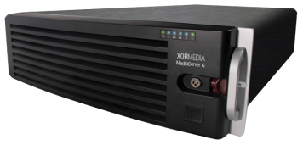
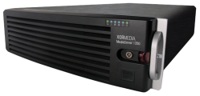
XOR Media Architecture
Production/MAM
Play Back
Play to Air (SD/HD/4K)
AVID
FCP
DALET
ADOBE
PREMIERE
FTP
SMB2
SMB2
NetDisk
Journalist
Videos / Images
HTTP
SDI
Cloud Aqua
LAN/WAN
SMB2
Video clips/
Templates
Ingest
IPTV
Automation
API/VDCP
Playlist Preload
Media Server C
API/VDCP
XOR Media
Controller
Tool
Cloud Aqua
Media Server C
Traffic System
3rd Party
Automation
3rd Party
Traffic System
IP Stream
CDN
Baseband
Live
feed
Studio
Outside
Broadcast
Live
3rd party Cloud

Slide 3
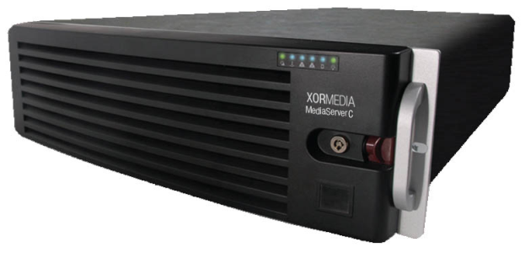
MediaServer C Series
Multi-channel SD/HD/4K Video Server
Notes:
Low Cost
o ~50 cents/GB (can go lower if we make desktop-class SATA work stably with SHAS)
· High Density Architecture
o 2 heads (in non-HA configuration), each controlling 35 x 3.5” SAS/SATA drives, housed in a 4RU package
· Optimized ingest and streaming bandwidth
o Ext4 file system (multi-allocator and delayed allocation for simultaneous writes clustered into continuous layouts), SHAS write back cache and read ahead (for bursts of sequential writes/reads)
· Virtualized storage pool with NGOD support
o A3 for ingest and C2 for CDN transport, no external application or SRM necessary to determine content’s physical location
· Integrated RGB packager (for 3-screen formats)
o Allows RSDVR to be encoded in several bitrates of H.264 and then only packaged into FLV, HLS, etc. in real time when customers actually demands it from a mobile device
o Integrated recording software (RestarTV), integrate with EPG source to initiate recording based on EPG

Slide 4
Hardware Components
3RU server chassis
System boot disk: SSD, 128GB or above
Redundant, hot-swappable power supplies
Up to 8 input/output ports
Video Storage Options:
With UML N
With local storage eight or sixteen 240GB/480GB/960GB/1.92TB/3.84TB (SSD) or 1TB/2TB/4TB/8TB (HDD)
RAID6 protection of HDD/SSD local storage (optional)

Slide 5
I/O Configuration
SD/HD
Maximum of 8 Playout Channels
Maximum of 8 Ingest Channels
The Configuration of the Codec Pack is ‘a la carte’
Configurable as SD only or HD only or HD/SD switchable
4K
1 Playout Channel
Support HD Up Conversion to 4K

Slide 6
Software Components
Software codec configuration for SD only or HD only, SD/HD switchable or 4K
Encode and decode support for multiple video formats
Support for up conversion, down conversion and cross conversion
Support for Close Caption and Teletext
Support for graphic like logo, image
Support for Aspect Ratio conversion
Support for VDCP, Sony and MCCAPI Control

Slide 7
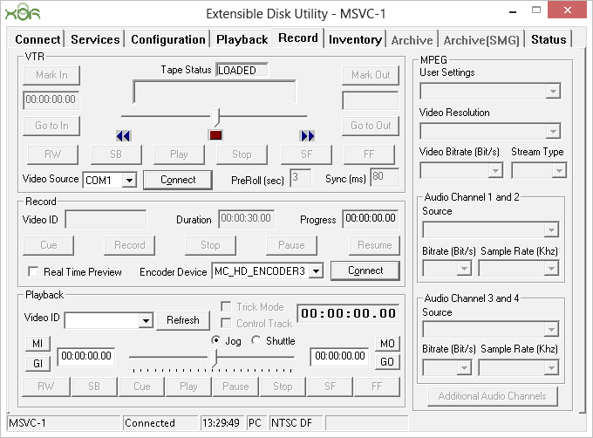
Configuration Utility

Slide 8
Multi-functionality
Perfect for direct ingest and playout
Embedded FTP server minimizing system fragmentation as much as possible (available for local storage)
Embedded SMG Lite for file ingest/file transfer (available for local storage)
Direct streaming with XOR UML N CloudAqua Storage

Slide 9
High Density and Reliability
High Density
Easy to expand with increasing density requirements
High Reliability
Redundant, hot-swappable power supplies
Flash SSD boot disk for high-speed booting and extra reliability
RAID6 protection against 2-drive failure

Slide 10
Open Technology
Support various media file formats
Offers open media format supporting for MPEG-2, DV, MXF, QuickTime, MOV, DNxHD and AVC-Intra, etc.
Back-to-back playout of multi-formats and multiplexes
Seamless Integration
Communicates with third-party applications such as automation system via VDCP or API and media asset manager via API
Works with XOR MediaController Application for recordlist/playlist scheduling and controlling
Able to work with XOR UML N CloudAqua

Slide 11
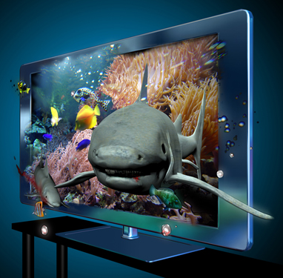
Technology Advances
Scalability
Beginning with 4 channels scalable up to 8 channels
Upgrade Kit expands local storage capacity up to 128TB
HD-Capability
Support for 8 HD channels of 1080i and 720p or 4 simulcast channels
HD/SD switchable
Support for up/down conversion and cross conversion
UHD-Capability
Support for 1 UHD channel
Support for HD Up Conversion

Slide 12
Highlights
A la carte channel configuration
Support for up/down and cross conversion
MPEG-2, DV, MXF, QuickTime, MOV, DNxHD, AVC-Intra and XAVC format support
Direct streaming with local storage or XOR UML N CloudAqua storage
Up to 128TB local storage
Broadcast Quality Server

Slide 13
Thank you!
Notes:
Low Cost
o ~50 cents/GB (can go lower if we make desktop-class SATA work stably with SHAS)
· High Density Architecture
o 2 heads (in non-HA configuration), each controlling 35 x 3.5” SAS/SATA drives, housed in a 4RU package
· Optimized ingest and streaming bandwidth
o Ext4 file system (multi-allocator and delayed allocation for simultaneous writes clustered into continuous layouts), SHAS write back cache and read ahead (for bursts of sequential writes/reads)
· Virtualized storage pool with NGOD support
o A3 for ingest and C2 for CDN transport, no external application or SRM necessary to determine content’s physical location
· Integrated RGB packager (for 3-screen formats)
o Allows RSDVR to be encoded in several bitrates of H.264 and then only packaged into FLV, HLS, etc. in real time when customers actually demands it from a mobile device
o Integrated recording software (RestarTV), integrate with EPG source to initiate

